Slide 1
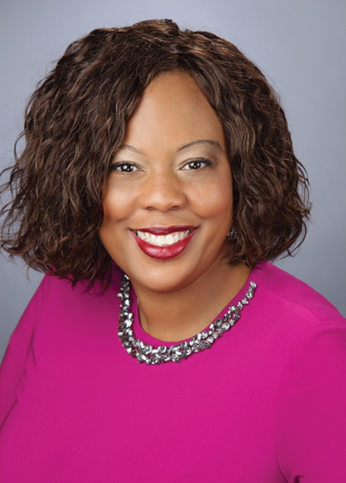
PRSA EAST CENTRAL DISTRICT
LEADERSHIP QUICKSTART CONFERENCE 2019
“Future Facing”
Sept. 13-14, 2019
Professor Shanita Baraka Akintonde, MBA, M.Ed., DTM
National Chair, PRSA National Diversity & Inclusion Committee

Slide 2
What is Diversity?
Tell yourself.
Tell a partner.
Tell us.

Slide 3
The 7/11 Rule on Perception
Family Status
Mode of transportation
Favorite Musical Genre
Favorite Ice Cream Flavor
Favorite Color
Children?
Age

Slide 4
National Chair, PRSA Diversity & Inclusion Committee Member, Global Affairs Committee Tenured faculty member 20-years of combined teaching and administrative leadership 26-year member PRSA PR and Advertising Account Sup Porter Novelli, Burrell, DDB, BBDO MBA, Illinois Institute of Technology M.Ed., Loyola University Chicago BA, Columbia College

Slide 5
Professor Shanita Akintonde Books
Unleash the Leader Within You: How to Achieve the Success That You Deserve
Hear Me R.O.A.R.R (Fall 2019)
Leading From the Heart (Fall 2018)

Slide 6
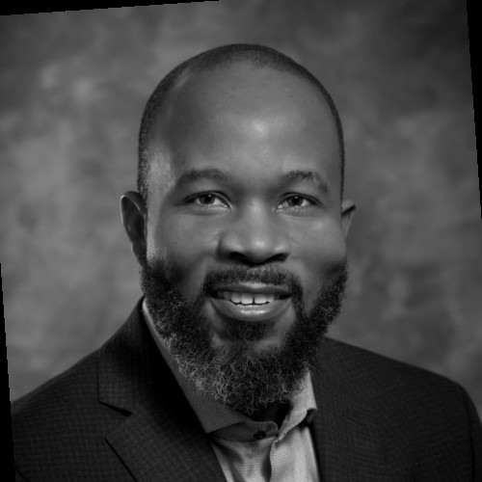
Jimmy Akintonde Jimi Akintonde Anthony Akintonde
President & CEO Civil Engineering Student Freshman
UJAMAA Construction, Inc. Illinois Tech Morehouse College

Slide 7
What is Diversity in PR?
“To champion diversity of thought, cultures, disciplines, ideals, gender, disabilities, sexual orientation and age in order to develop an inclusive Society. By reaching and involving members who represent a broad spectrum of differences, we will encourage and educate members about the benefits of a diverse profession by providing professional development, knowledge and support to help them succeed in public relations.” PRSA Diversity Toolkit

Slide 8
The Perception

Slide 9
Feature Films are the Result of Years of Scientific Study Combined with the Experience of Years

Slide 10
Feature Films are the Result of Years of Scientific Study Combined with the Experience of Years

Slide 11
The Reality

Slide 12
How do we do it?
Make PRSA a more inclusive and welcoming Society by reaching out to industry professionals of diverse racial backgrounds, ethnicities and sexual orientations.
Help to diversify the industry by supporting minority candidates who aspire to a career in public relations by helping them develop industry familiarity and knowledge, relevant skills and a network of professional contacts.
Bring multicultural understanding and expertise to public relations professionals in order to address the diverse audiences in the nation.

Slide 13
What areas of interaction impact diversity?
Agency/Corporate Culture
Senior Executives
Support
Staff
Clients
Entry-level
employees
Cafeteria Workers
Janitorial Staff

Slide 14
My C.A.R.E. Conceptual Frame
C---Commitment to ”Inclusive Excellence” in the workplace
A---Advocating Organizational Success
R---Reaching and Retaining Underrepresented Groups
E---Embodying Principled Leadership

Slide 15
What can you do?
● Establish formal relationships with schools that have diversity in their student bodies. This measure will ensure that you are always cultivating talent for your future talent pool.
● Cultivate organization partnerships with groups that cater to the needs and interests of minority candidates (e.g. people of color, women, people with disabilities, etc.). When using a panel, make sure that it is culturally diverse to minimize potential bias.
● Create intentional content for diversity initiatives
.

Slide 16
What MORE Can you do?
Incorporate nontraditional networking channels to produce a diverse applicant pool. A strong diverse.
Encourage senior people of color, women and people with disabilities in your organization to assist in providing names of possible recruits.
Evaluate Each Component of Your Diversity and Inclusion Initiative

Slide 17
W.Y.T.B.W???

Slide 18
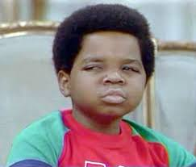

Slide 19
And more still…..

Slide 23
PRSA Chapters get in on the action

Slide 24
... Size and placement of photographs and the relationship of the image to other elements on a page can have a significant impact on the visual language (Harrison, 2003). The use of photographs allow for the creation of strong viewer involvement and the use of the human face in particular is one of the most powerful resources in visual imagers because humans are trained from a young age to study faces and expressions (Harrison, 2003). ...
Visual Social Semiotics: Understanding How Still Images Make Meaning, Claire Harrison, 50(1):46-60 · February 2003

Slide 25
Intersectional Identities; Transcending the Binary through Binary Code by Kelsey Fox Excerpt

Slide 26
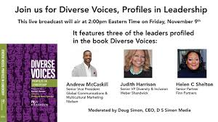

Slide 27
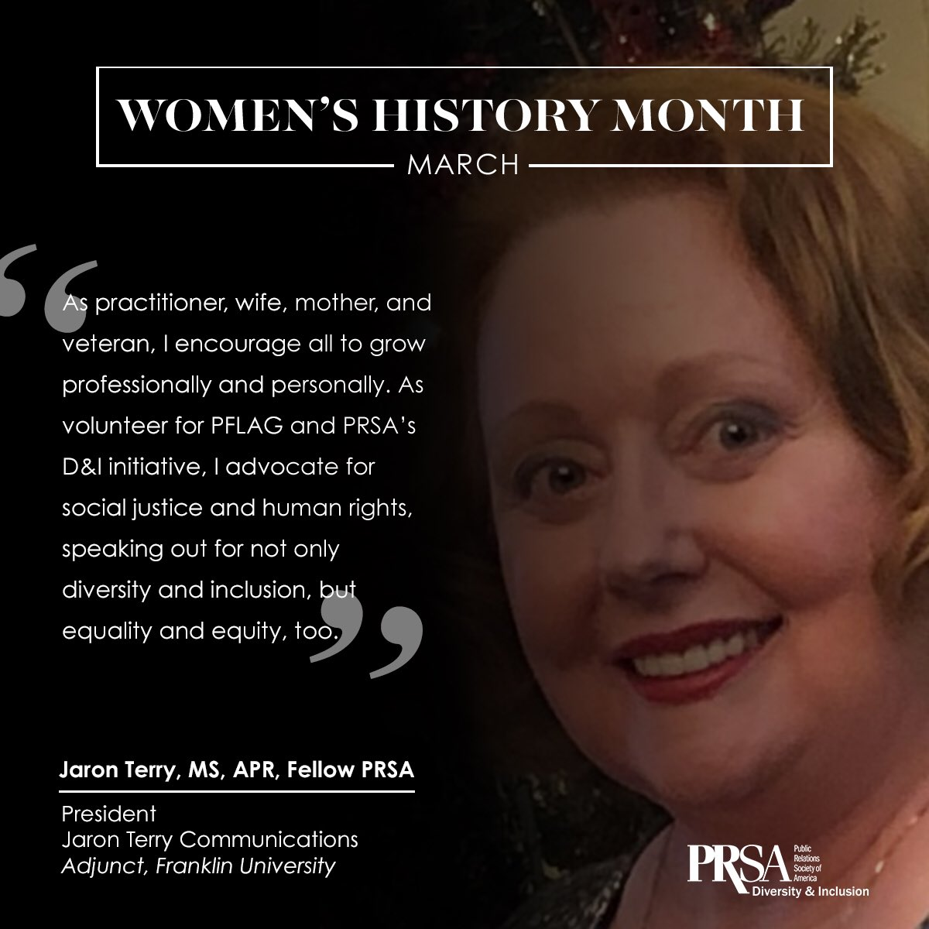

Slide 28
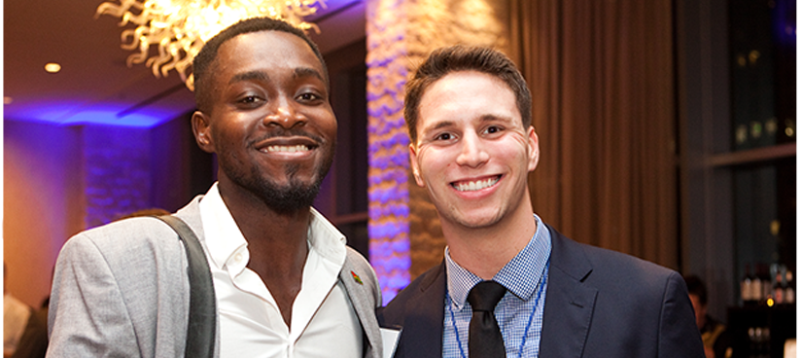
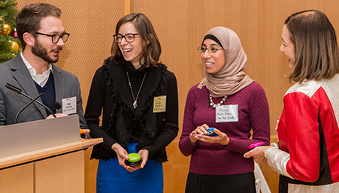
PRSA Chapters: Ohio
Akron Area Chapter Base: Akron, OH Chapter Administrator: Lianne M. Fowler President: Jennifer Lynn Kramer, APR
Central Ohio Chapter Base: Columbus, OH Chapter Administrator: Karen Kaiser President: Alicia Shoults
Cincinnati Chapter Base: Cincinnati, OH Chapter Administrator: Elliot Campbell President: Erin Elizabeth Rolfes, APR
Dayton Area Chapter Base: Dayton/Miami, OH President: Linda M. Dininger
Greater Cleveland ChBase: Cleveland, OH Chapter Administrator: Lynn Bracic President: Bob R. Rotatori
Northwest Ohio Chapter Base: Bowling Green/Toledo, OH Chapter Administrator: Kari L. Bucher President: Jared C. Meade, APR
River Cities Chapter Base: Ashland, KY/Portsmouth, OH/Huntington, WV President: Kaylin Staten, APR

Slide 29
Inclusiveness At Work

Slide 30
Get Leadership’s Commitment
Communicate, Communicate, then Communicate more
Evaluate Your organization’s needs and issues
Develop a leadership and retention plan
Emphasize competence-based credentials

Slide 31
Questions ??????????????? Sakintonde@colum.edu

