Slide 1
“Show Me the Money” Best Practices Roundtable Discussion on Chapter Fundraising & Sponsorships Jennifer Flowers-Kolf, APR, PRSA ECD Board
Saturday, Sept. 30, 2017

Slide 2
AGENDA
Best practice examples of chapter fundraising from PRSA Detroit
Q&A with Detroit/Akron leaders present
Group roundtable discussion

Slide 3
PRSA Detroit Fundraising and Sponsorships
Chapter sponsorship program started in 1997
One chair from the corporate world (Comerica) and one chair from the agency world (JB&A)
Raised $7,500
In 2009 (when the economy tanked), we were still able to raise $18,000
Average has been $26,000 a year
Over the past 21 years – a total of $555,925 raised

Slide 4
PRSA Detroit Fundraising and Sponsorships
PRSA Detroit treasurer serves as fundraising/sponsorship chair
Fundraising/sponsorship chair solicits members for company sponsorships; board is key here too
Board expected to assist with follow up calls
Chapter president’s company typically signs on with a premium sponsorship

Slide 5
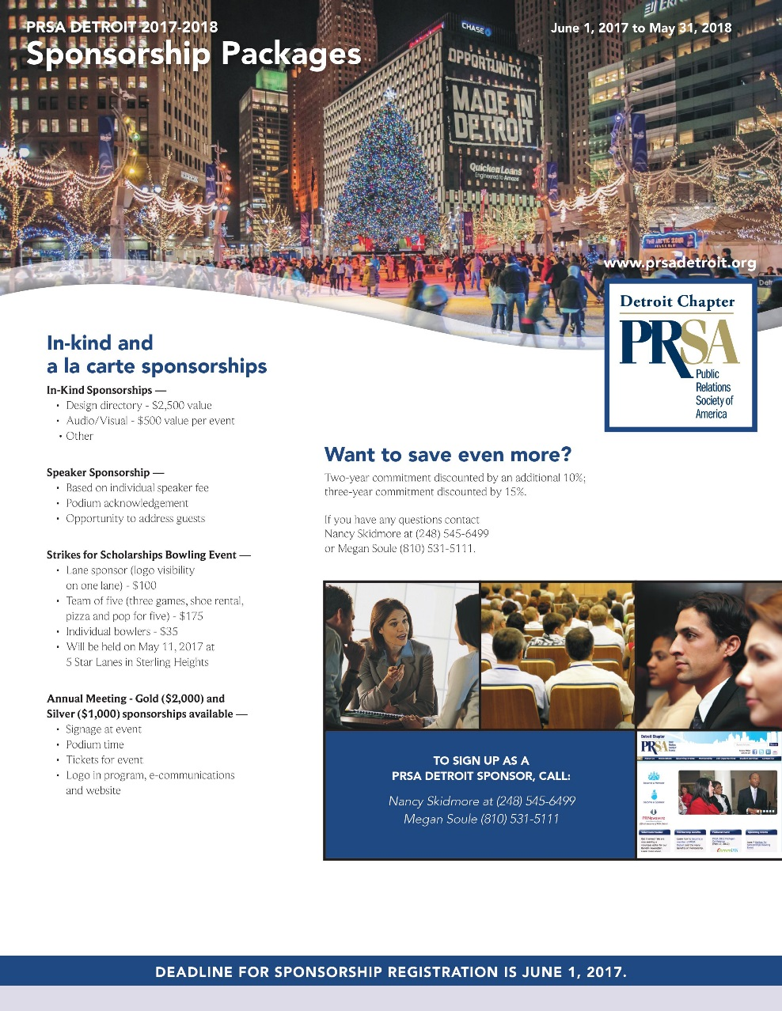
PRSA Detroit Sponsorship Packages

Slide 6
PRSA Detroit Fundraising and Sponsorships
Money raised used to augment chapter programs
Bring in higher interest speakers
Add special features to events (food, drinks, etc.)
Pay for needed chapter technology and equipment upgrades
Training and equipment for administrator
Chapter insurance
Special awards and recognitions
Volunteer thank yous or awards

Slide 7
PRSA Akron
Discussion

Slide 8
PRSA Detroit and Akron
PRSA Akron examples
Q&A with Detroit and Akron leaders

Slide 9
Fundraising and Sponsorships – Roundtable Discussion
Does your chapter have a formal sponsorship program for the year or do you simply host an annual fundraising event? What are the benefits of each?
Whose job is it on your chapter’s leadership team to generate funding for the chapter?
What are some successful fundraising event ideas that your chapter has generated or that you’ve experienced in other facets of your life?
What are some of the biggest challenges you face in fundraising for your chapter?

Slide 10
Thank You!
Jennifer Flowers-Kolf, APR
JFlowe28@forddirect.com

