Slide 1


PRSA Detroit:
Diversity and Ethics
Saturday, Sept. 30, 2017

Slide 2
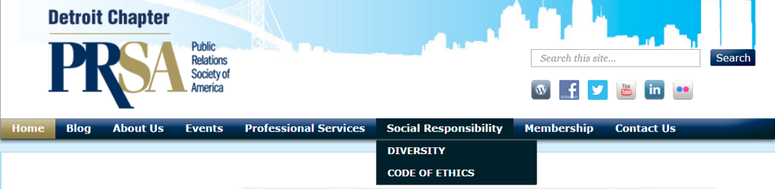

PRSA Detroit: Diversity and Ethics
Ofield Dukes Diversity Summit
LGBT Community
Ethics Outreach, Events and Webinars

Slide 3

PRSA Detroit: Diversity

Slide 4
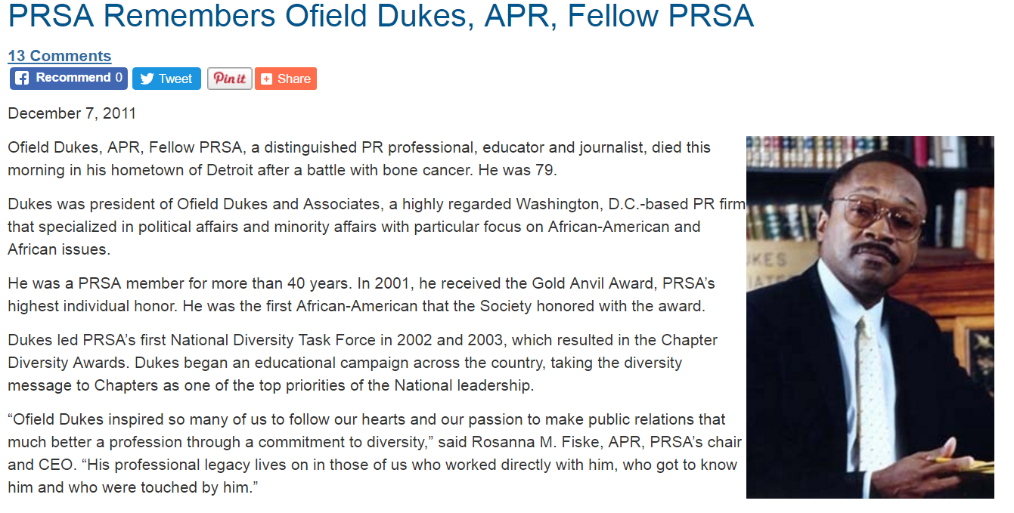

PRSA Detroit: Diversity

Slide 5

PRSA Detroit: Diversity
Diversity Committee
“Diversity is often framed as a ‘challenge’ that we must overcome. But it’s time to look at it as an opportunity to learn.”
Matthew Seeger, Ph.D., dean, College of Fine, Performing and Communication Arts at Wayne State University,
in his closing remarks at the 2012 Ofield Dukes Diversity Summit
PRSA Detroit’s diversity committee aims to:
1. Provide members with educational and professional diversity programming.
2. Diversify the PRSA membership and areas of chapter participation.
3. Share diversity focused content for members and visitors of interest.

Slide 6
Diversity
Ofield Dukes Diversity Summit (Feb. 16, 2012)
Over 120 public relations students and professionals gathered in Detroit for the first-ever Ofield Dukes Diversity Summit, presented by PRSA Detroit, General Motors and The Wayne State Department of Communication in honor of the late Ofield Dukes, APR, Fellow PRSA – a distinguished PR professional, educator and journalist.
The program sought to redefine “diversity” beyond race and ethnicity and explore its meanings for the public relations profession; examine the role of diversity within the profession, publics and the process; and offer strategies and tactics for communicating with diverse audiences

Slide 7
Diversity
Diversity Deep Dive: Connecting with the LGBT Community & Media (June 27, 2012)
During National Gay & Lesbian Pride Month, PRSA teamed up with Jan Stevenson, co-publisher of Between The Lines and Antonio David Garcia, Executive Director at Affirmations for an in-depth look at: who the LGBT consumer is, why they’re important to public relations professionals and how to effectively communicate and develop relationships with the LGBT media and community resources.

Slide 8

Diversity
Ofield Dukes Diversity Summit | Second Annual (May 15, 2013)
More than 85 public relations practitioners, scholars and students gathered at Wayne State University on May 15 to explore the challenges and opportunities presented by the inherent ethnic and cultural diversity of southeast Michigan, and the links between public relations, diversity, social responsibility and ethics.
The second annual Ofield Dukes Diversity Summit – sponsored by PRSA Detroit, General Motors and the Wayne State University Department of Communication – serves as a tribute to Ofield Dukes, APR, Fellow PRSA, a trailblazing champion of diversity and social responsibility who died in 2011.

Slide 9

Diversity
Ofield Dukes Diversity Summit | Third Annual (Oct. 23, 2014)
More than 100 public relations practitioners, scholars and students gathered at Wayne State University to explore communicating and working with cross-generations. The third annual Ofield Dukes Diversity Summit – sponsored by PRSA Detroit, General Motors and the Wayne State University Department of Communication – offered an engaging setting for attendees to:
  Learn how boomers and millennials can work successfully together – what they’re teaching each other in the PR work environment.
  Learn how to encourage cooperative working relationships in the PR work environment for maximum efficiency, collegiality and project success.
  Learn how to work with cross-generations to successfully target messages and attract audiences.
  Hear about successful a local PR campaign targeting millennials.
  Participate in dialogue with media about reaching cross-generational audiences and preparing cross-generational content.

Slide 10
Diversity
Ofield Dukes Diversity Summit | Fourth Annual (Oct. 22, 2015)
PRSA Detroit’s community convened at Wayne State University to explore how professionals can recognize and overcome inherent bias in communications and hiring. The summit, which was sponsored by General Motors and the Wayne State University Department of Education, offered attendees the opportunity to:
  Learn what inherent bias is and how to identify it in themselves and their communications
  Hear legal, diversity and community leaders speak on the value of overcoming inherent bias in your communications and interpersonal relationships
  Learn ways to overcome inherent bias in PR and personal communications and hiring practices for more authentic and effective outcomes

Slide 11
Diversity
Ofield Dukes Diversity Media Roundtable (Nov. 2, 2016)
PRSA Detroit hosted a media roundtable moderated by Jack Lessenberry, Michigan Radio’s senior political analyst and area head of the journalism faculty at Wayne State University. Sixty PRSA Detroit members and professionals and 30 PRSSA members from Wayne State University attended the event, which featured presenters from the Arab American News, BLAC Detroit Magazine, the Chaldean News, and El Central. The roundtable discussion highlighted:
  How public relations professionals can tailor their pitches to meet the needs and pique the interest of metro Detroit’s diverse communities
  How to expand your audience, broaden your professional network and learn from your colleagues

Slide 12
Diversity
Connecting with the LGBT Community (June 28, 2016)
PRSA Detroit teamed with Affirmations, a community center serving the lesbian, gay, bisexual, transgender (LGBT) populations, Between the Lines, Michigan’s weekly LGBT community newspaper, and Equality Michigan, Michigan’s only statewide anti-violence and advocacy organization working primarily for the LGBT community to share insight on:
  The LGBT consumer
  The community landscape and its evolution
  Hot button issues
  The political landscape
  Why this audience is important to communications professionals
  How to effectively communicate to and develop relationships with the community and the media

Slide 13

Diversity

Slide 14
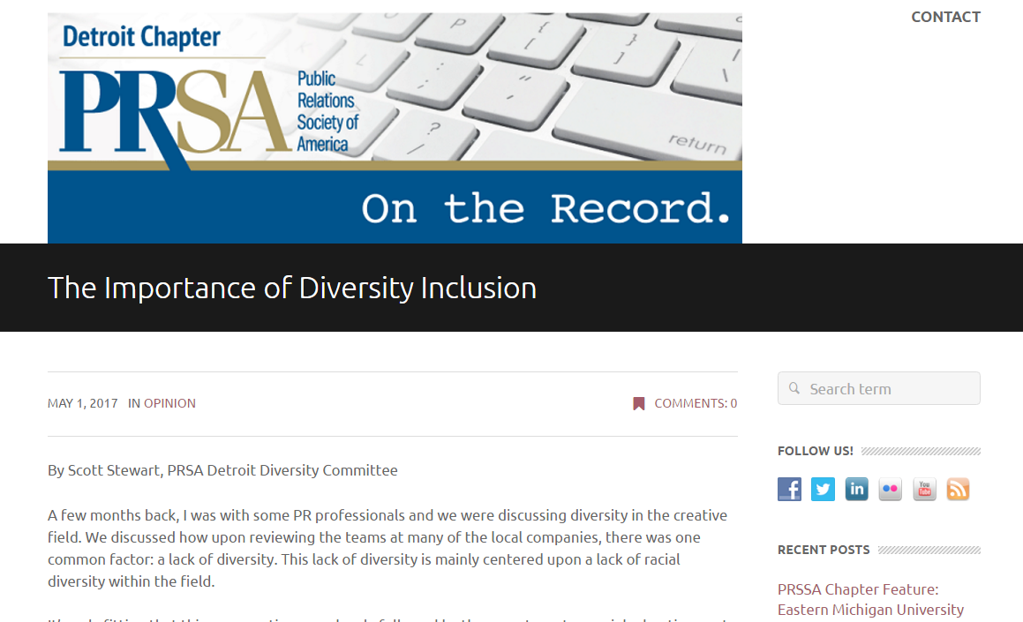
Diversity – Blog Use

Slide 15
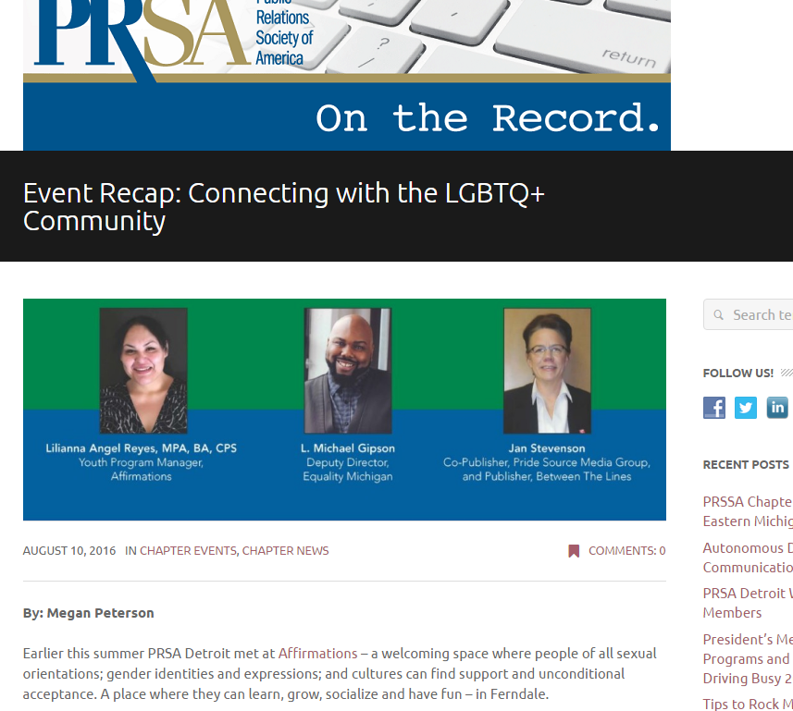
Diversity – Blog Use

Slide 16
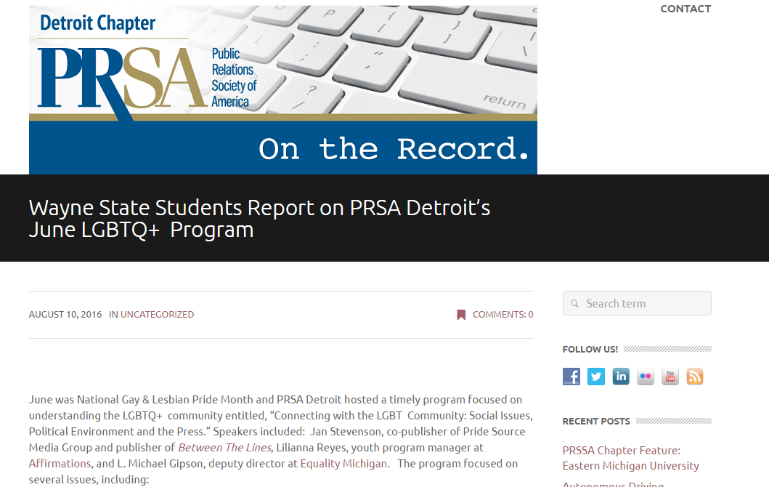
Diversity – Blog Use

Slide 17

PRSA Detroit: Ethics

Slide 18
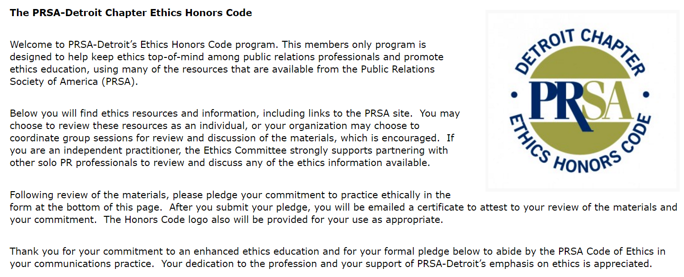
Ethics

Slide 19
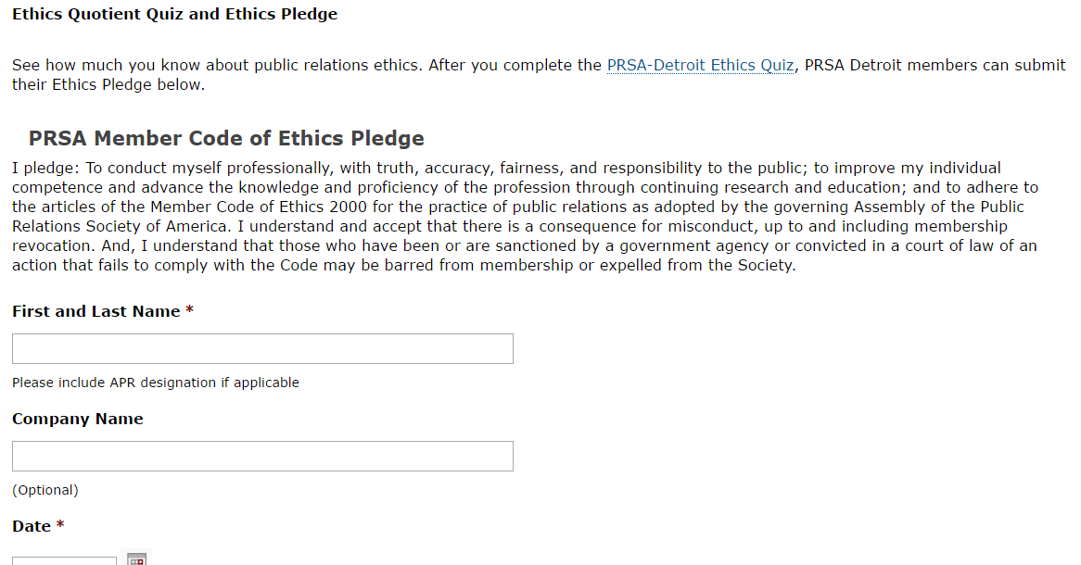
Ethics

Slide 20
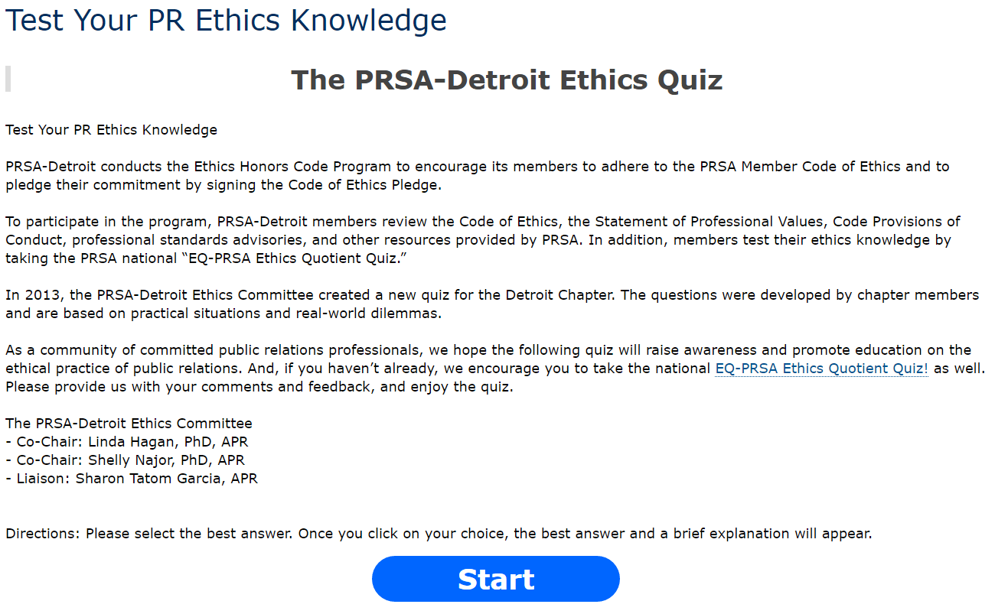

Ethics

Slide 21

Ethics

Slide 22
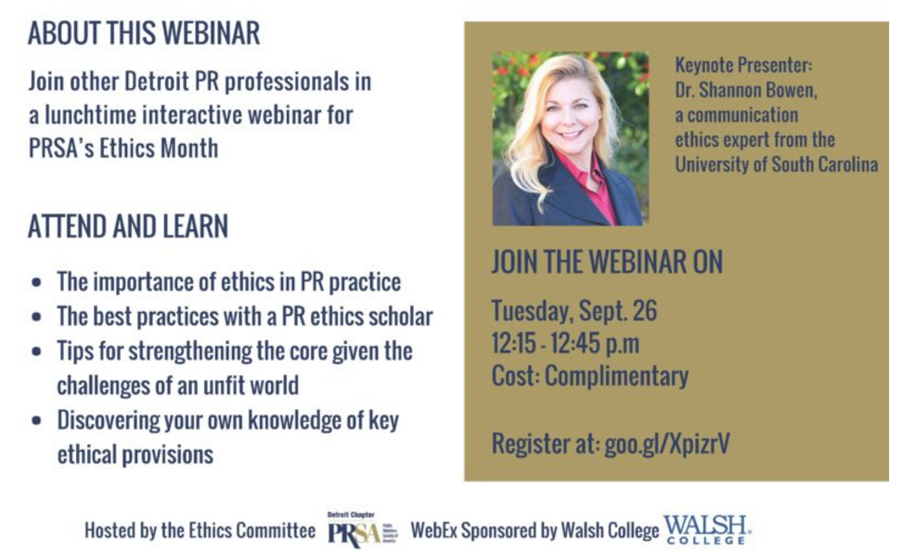
Ethics

Slide 23
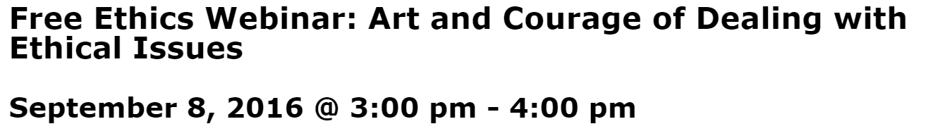
Ethics
As the ethics counselor of organizations, public relations practitioners seek to work with senior executives from a variety of departments to develop allies and form coalitions when their own power is limited. This skill requires political shrewdness to identify key influencers who make the decisions and is a critical tool when dealing with ethical issues. As a result, persuasive skills are also required to convince the influencers to adopt ethical alternatives.
This ethics webinar will:
Discuss how to recruit allies and form coalitions as a means to influence more senior executives.
Provide examples of persuasive techniques that can be used to raise ethical concerns

Slide 24

Ethics

Slide 25
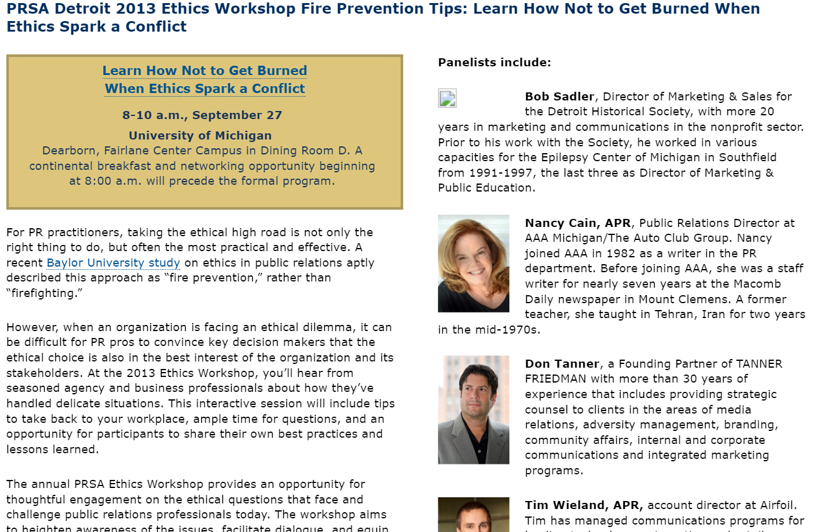
Ethics

Slide 26
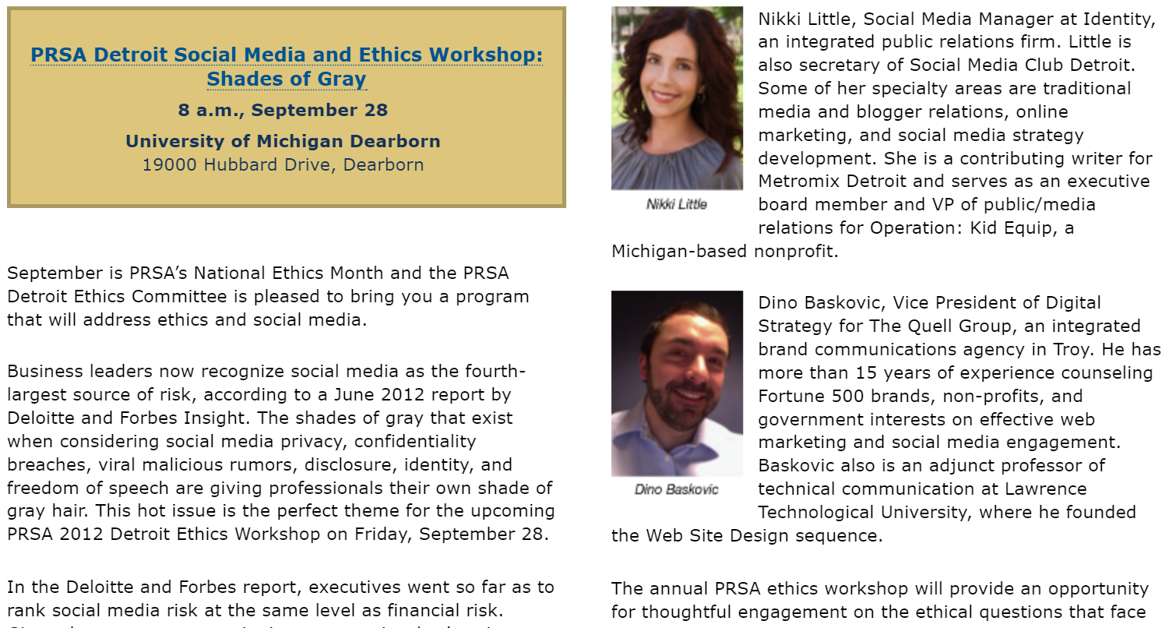

Ethics

Slide 27
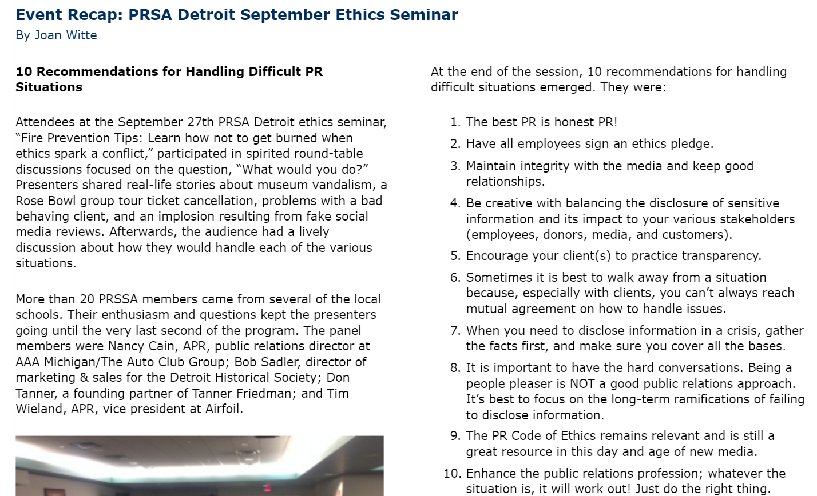
Ethics – Blog/Newsletter Use

Slide 28
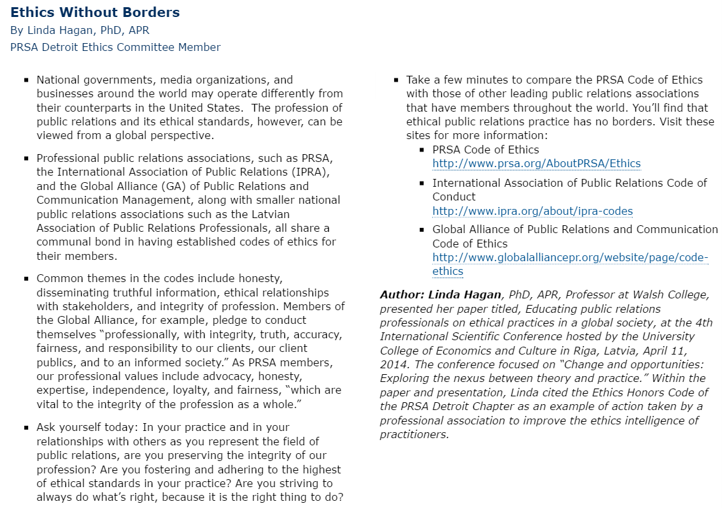
Ethics – Blog/Newsletter Use

Slide 29
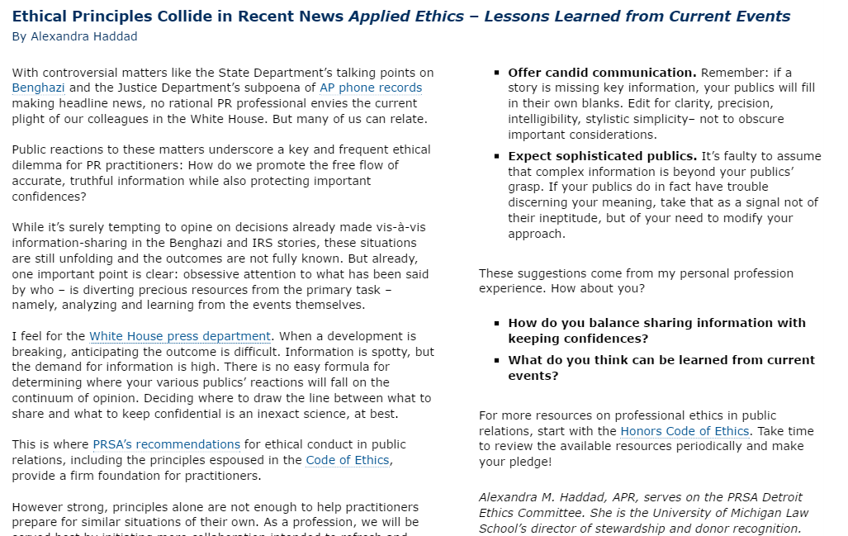
Ethics – Blog/Newsletter Use

Slide 30
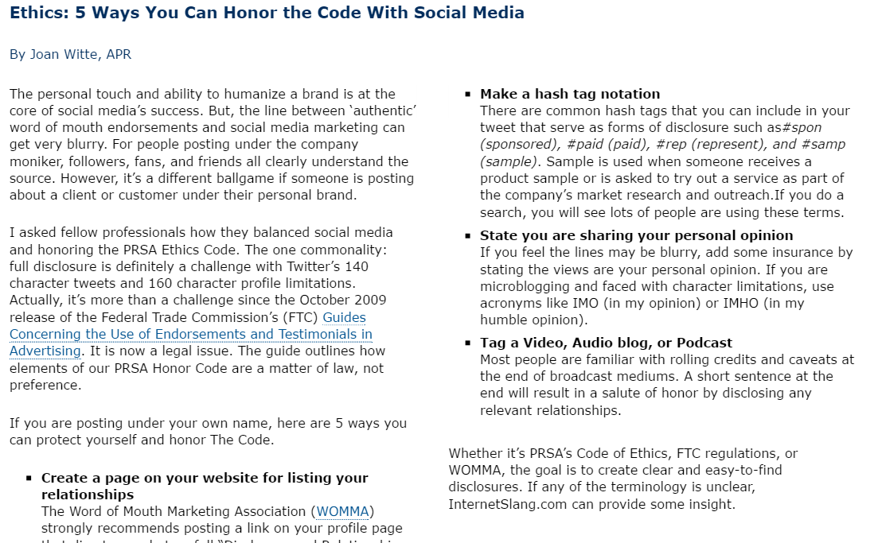
Ethics – Blog/Newsletter Use

Slide 31
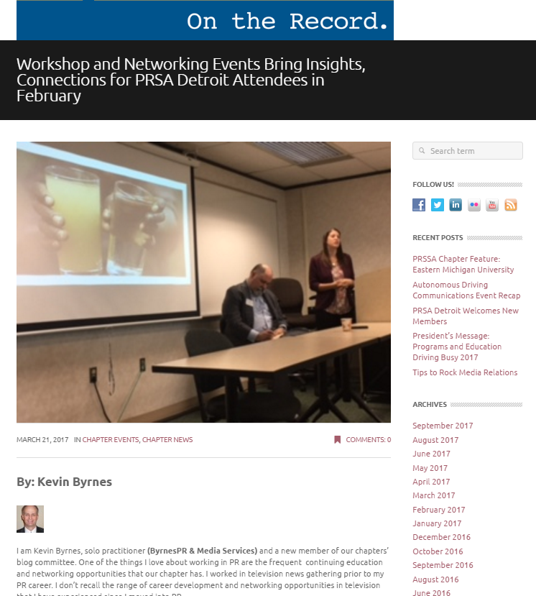
Ethics – Blog/Newsletter Use

Slide 32
Thank You!

