Slide 1
Member Benefits

Slide 2
PRSA: Your network
National
10 Districts
21,500 Members
110 Chapters
Special Interest Sections
College of Fellows
Counselors Academy
Association/Non-Profits
Corporate Communication
Educators’ Academy
And adding more!

Slide 3
What do members find valuable?
Code of Ethics
Networking provided by local chapters
Professional development programs by local chapters
Offering preferred member pricing for professional development
PRSA’s website
Free webinars
PRSA Job Center
Electronic library of PRSA articles and case studies
APR program
Issues & Trends
Tactics
PR Strategist
Member directory
According to 2014 PRSA Study

Slide 4
How do you define the benefits of membership?
Website - MyPRSA

Slide 5
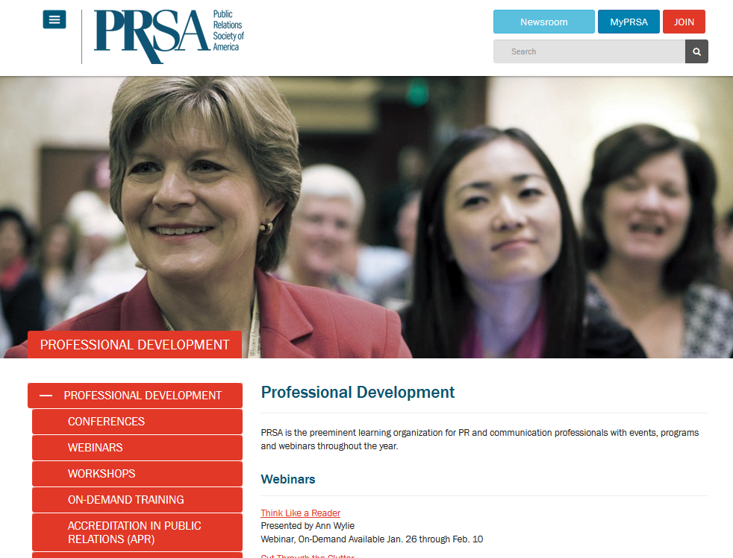
Member Benefits
Professional Development and Training
Free webinars
for
members

Slide 6
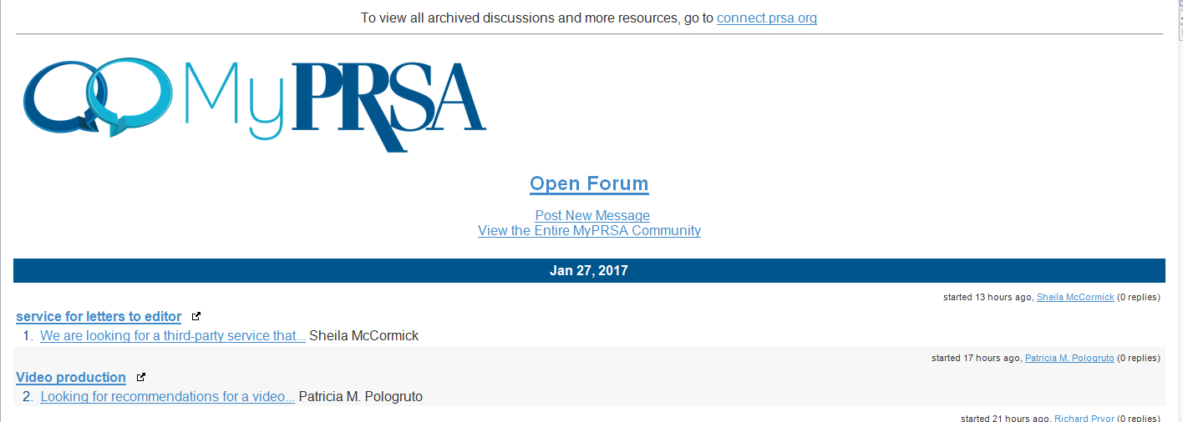
Member Benefits
Your Own Communities

Slide 7
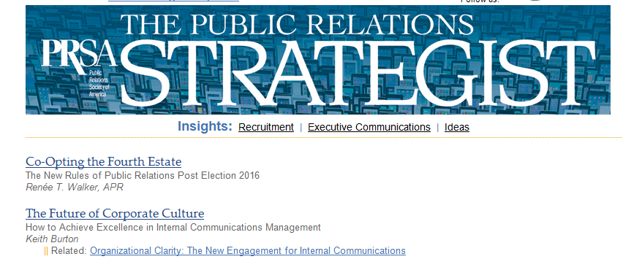
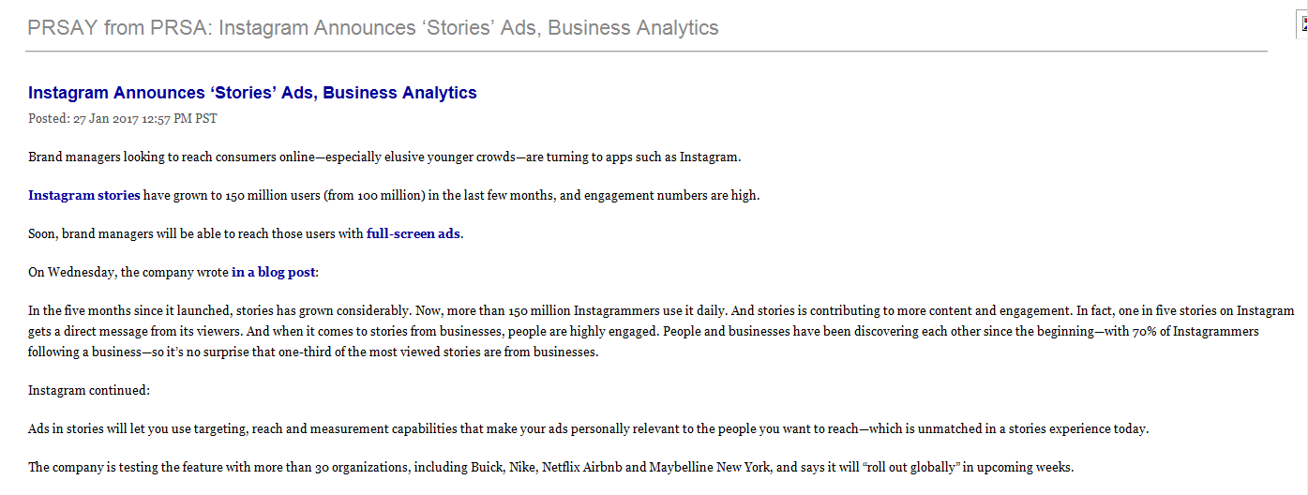
Member Benefits
Up-to-the-second Updates and Trends

Slide 8
Member Benefits
Accreditation - APR

Slide 9
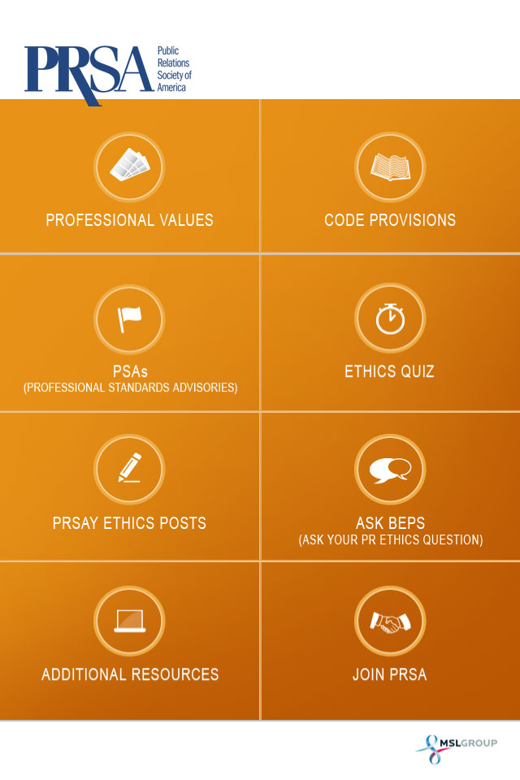
Member Benefits
Ethics App
Up-to-minute advisories on ethics issues
The entire Code with Professional Values discussion
Ethics quiz – try it between meetings
PRSay Ethics posts
Ask BEPS for your questions about ethical situations.

Slide 10
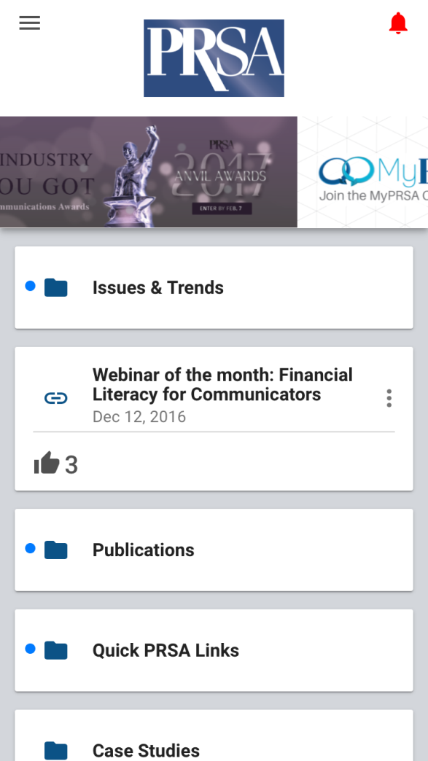
Member Benefits
Members’ App
Your personal PRSA web resource on your mobile device
Available on all platforms
Limited to members only

Slide 11
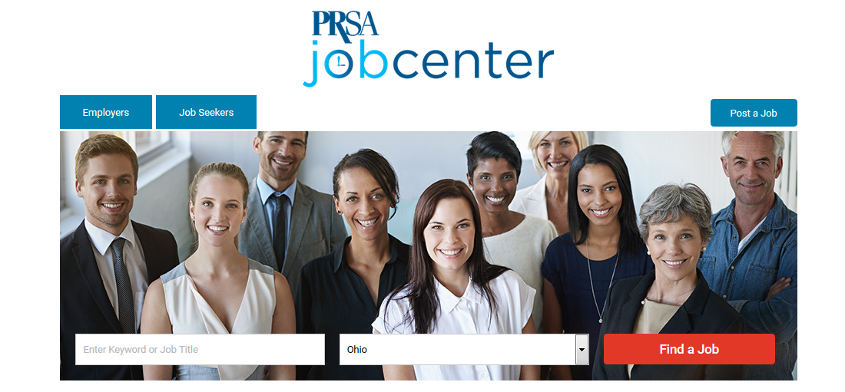
Member Resources
Job Center

Slide 12
Member Benefits
Virtual Job Fair

Slide 13
Member Benefits
Savings Center
Hotel Engine– reduced rates
Office Depot / Office Max
FedEx Express and ground shipping
Branded apparel and gifts
CDW computer supplies
Credit card processing
Online accounting services
Data and file back up
Internet and VOIP
Individual and group health insurance
and more

Slide 14
Member Benefits
Insurance Options
Individual and group
Professional liability
Health
And more

Slide 15
Member Benefits
Available from National – SEED Money
SEED money to assist with District and Quick Start Conferences

Slide 16
Sign up a team of five or more members for the first time - receive FREE Professional Interest Section membership and WAIVED initiation fee
Member Benefits
Group Membership

Slide 17
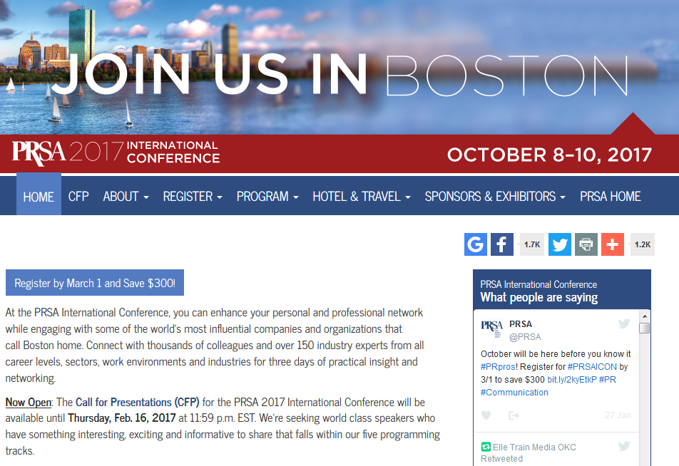
Member Benefits
2017 International Conference

Slide 18
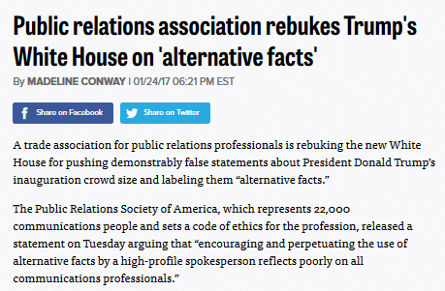
Member Benefits
Advocate for Public Relations

Slide 19
Who can help me or my chapter?
PRSA National Team Members
Jay Starr - Sr. Vice President, Member Services
Jason Barnhart - Director of Professional Development Michael Molaro - Manager, Member Services Cathy Wasner - Director, Membership Sales
Caroline Berman - Program Manager
Don Bill - Senior Manager, Special Events
Vada Wilson - Program Manager

Slide 20
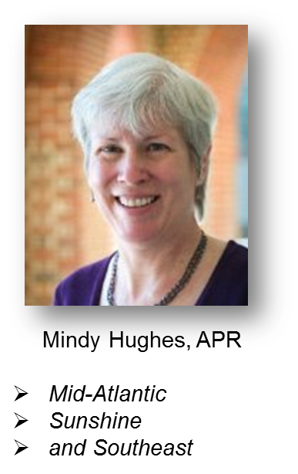
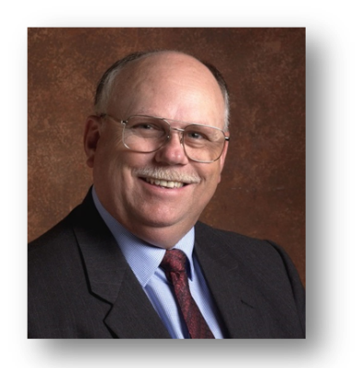
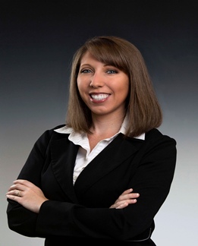
Regional Representatives
Mindy Hughes, APR
Mid-Atlantic
Southeast
Sunshine
Jill Alexander, APR, PRSA Fellow
Midwest
East Central
Don Mounce, APR
PRSA Regional Rep Manager
North Pacific
Southwest
Western
Crystal DeStefano, APR
Northeast
Tri-State

Slide 21
How can the Regional Representatives help?
District, chapter, member problem solvers
Your direct connection to national
Information conduit – what’s cool in one chapter or district – convey to others
Process explainers
Process therapists – constantly reviewing processes and changing or upgrading
Available for speaking gigs

Slide 22
Member Resources

